Slide 1
Break the monolith!
An intro to distributing your workload in the cloud
Jeff Putz - @jeffputz

Slide 2


Slide 3
Just kidding.
Welcome to Orlando Code Camp!

Slide 4
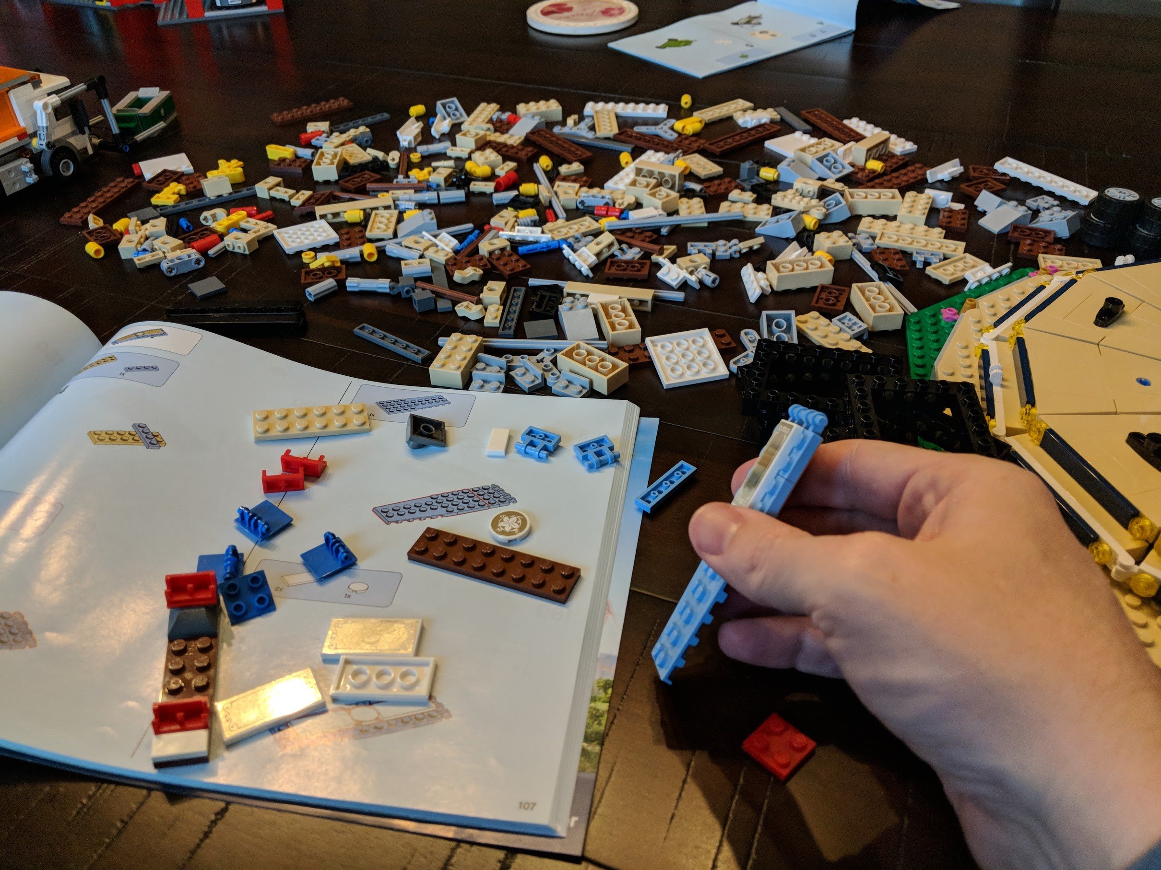

Slide 5
About me
Working the softwares since 1999-ish.
Diverse experience, from megacorps like Microsoft and Humana to startups and dot-com flameouts.
Currently VP of Product Development and Software Engineering for novi AMS (association management SaaS product).
Been hiring people on and off for the last ten years.
Current career stage: Visio, email and occasionally code.
Decks: https://github.com/jeffputz
jeff@popw.com and on the Twitter @jeffputz

Slide 6
Who this is for
Software developers, every level
Managers who want to understand distributed cloud computing

Slide 7
What is a monolith?
An application that exists largely as one code base executing in one place and persisting data nearby.
It must be wholly replaced at any given time when changed.
Also: Rectangular machines in the Space Odyssey books having a 1:4:9 ratio.

Slide 8
What is a distributed workload?
Many pieces of independent software working toward a common goal.
Communicate via messages.
Components can be changed independently.
Can execute tasks in parallel when necessary.
Might have shared state.
Performance is squishy.

Slide 9
Why do you need to split stuff up?
Running in the web context sucks for a hundred different reasons (starting with using resources meant to serve the UI).
Some things take a long time, and the stateless nature of HTTP and the browser isn’t intended to deal with that.
Makes the UI seem more responsive.
Computationally expensive things could slow things down for all users, making your app unresponsive.
Stuff may need to run on a timer, and the timer doesn’t run when your inactive site gets turned off.
You want to make it easier to change little parts of your system independently of other parts.
Easier to scale when many instances can work on stuff.

Slide 10
Real-life examples
Image manipulation
Synchronizing with a third-party service (email lists!)
Batch processing of data
Scheduled events (monthly billing)
Sending email

Slide 11
Most important rule of cloud:
Every instance of computing stuff is intended to be thrown away.
You can’t store durable files on it.
You can’t store state on it, especially in memory.
You never know when the actual instance of the software will disappear.
You don’t even know if the underlying hardware will be around much longer.
When you run on multiple instances, they don’t usually know about each other.

Slide 12
Basic architecture
UI
(1..n)
External Service
Queue
Task
Runner (1..n)
Chron
Database

Slide 13
The Toolbox
HTTP-serving web apps (VM’s, app services, web apps)
Transient storage: Queues
Durable or transient storage: Tables, blobs, doc db’s, etc.
“Serverless” compute (Functions, Lambdas; typically triggered by timers, HTTP hits, queues)
Databases
Memory caches (Redis, Memcached)
Service busses, messaging/signaling frameworks

Slide 14
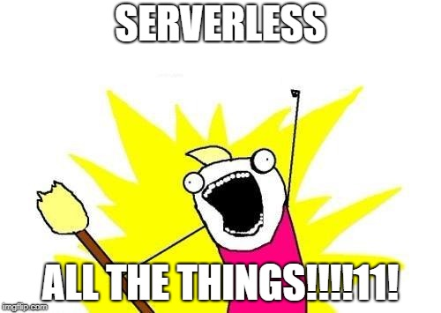

Slide 15
Questions?
jeff@popw.com
@jeffputz on the Twitter
https://github.com/jeffputz
https://jeffputz.com
@jeff.putz on the Instagram
Remember: Mentor others, you were once a beginner too.

